Slide 1


Slide 2
What is fresher adventure?
Finland’s biggest event for 1st year students (freshers)
On thursday 17.9.2026
  Joukkueiden ilmoittautuminen klo 2 pm – 5 pm
  Checkpoints are open 4 pm – 8 pm
  Afterparty at Apollo 10 pm –
Freshers (and their tutors) gather teams of 5 to 12 persons and complete checkpoints of different student organizations and stakeholders completing quests and collecting points on the way
The teams with the most points will be rewarded as well as the team with the best costumes

Slide 3
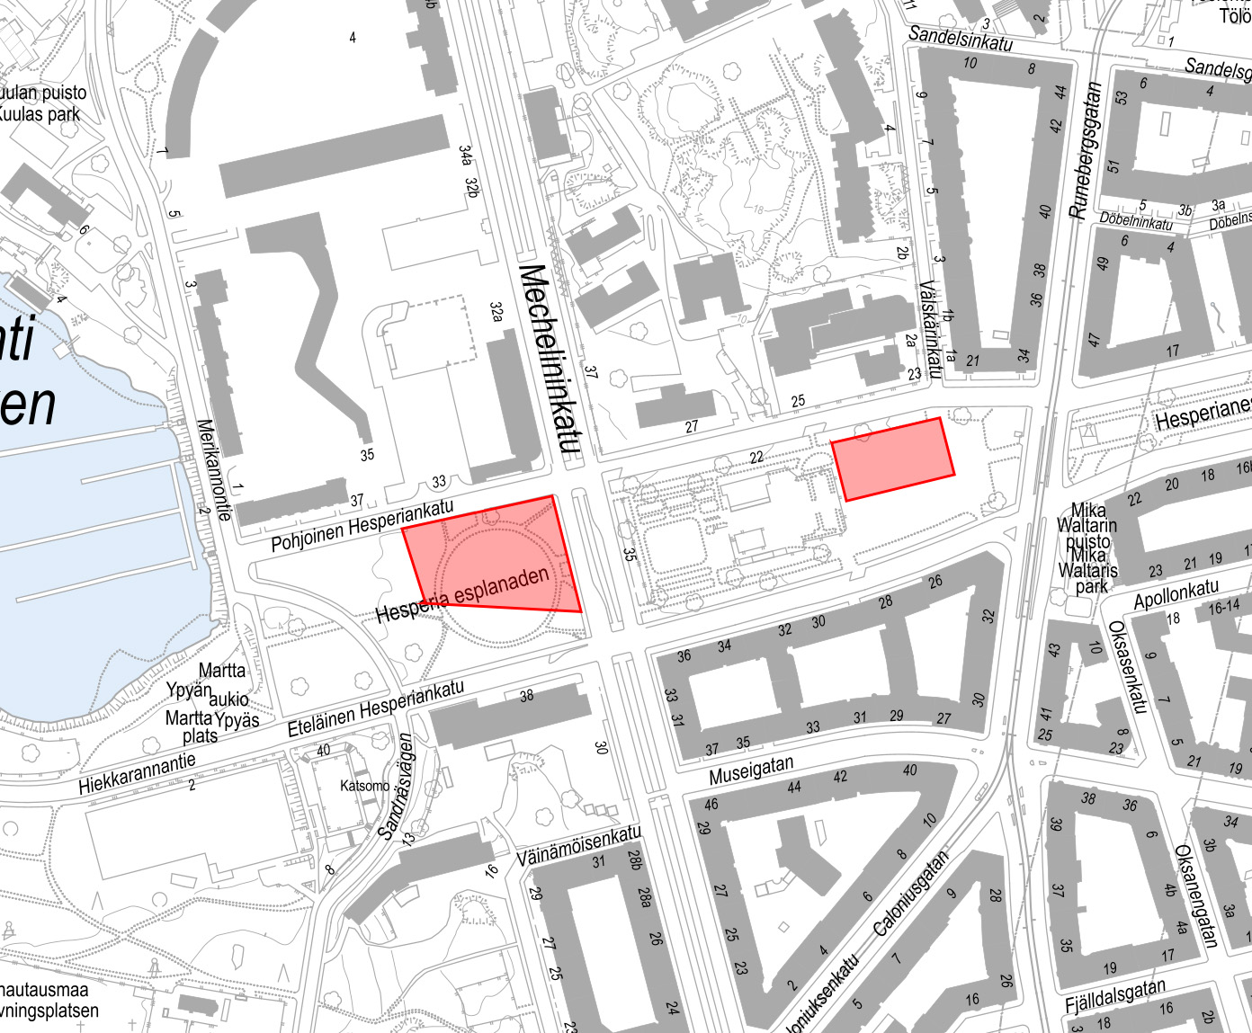
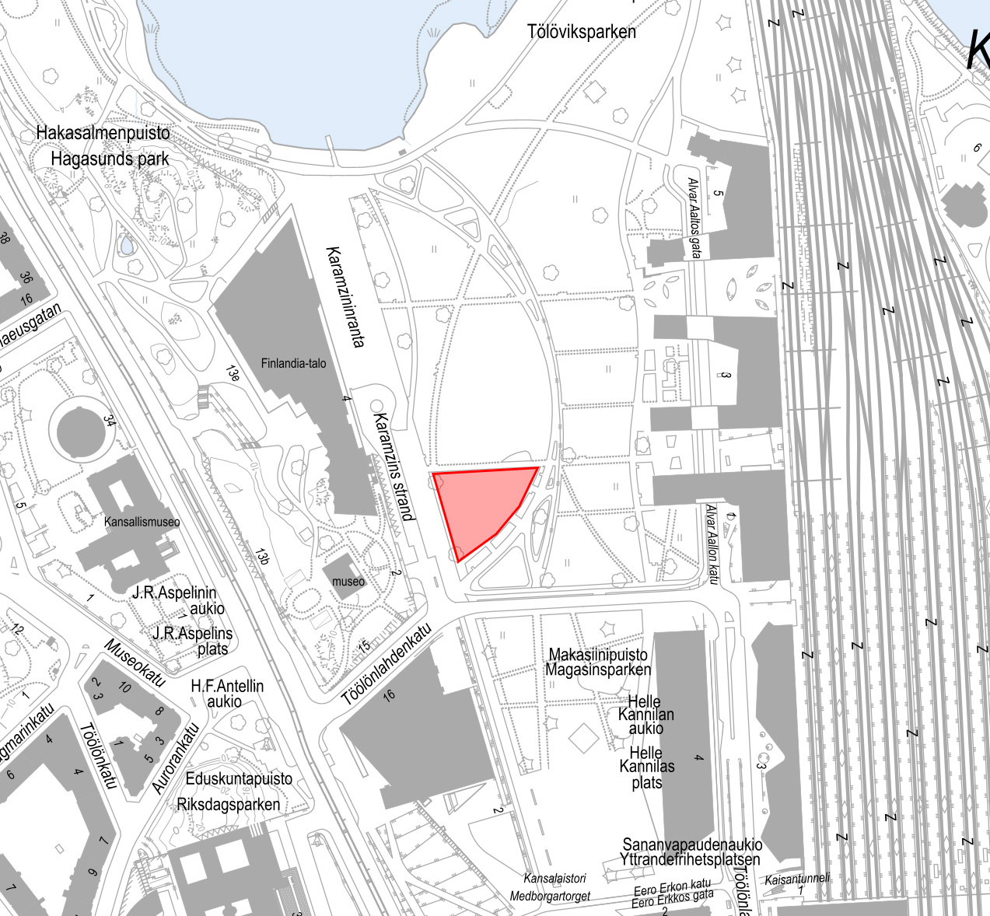
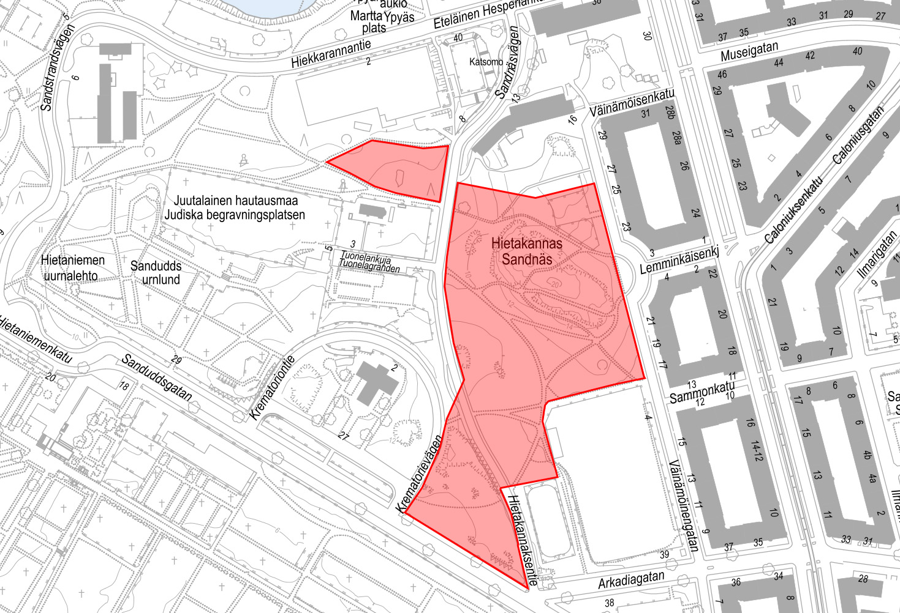
Also:
Domus Gaudium
Keskustakampus
Club Rooms

Slide 4
PERMITS - UPDATED 6.9.
The starting and finishing area has been moved from Kansalaistori to Töölönlahden tapahtumapuisto B-segment
Because of construction work in Kaisaniemenpuisto and Hakasalmenpuisto, no permits will be awarded for these areas
  These will both still be usable but checkpoints in either Kaisaniemenpuisto or Hakasalmenpuisto are not allowed to build temporary structures (=tents)
About tents
  Possible checkpoint tents must be put up according to the manufacturers guides and must comply with wind loads (=tents must be weighted)

Slide 5
Checklist for checkpoints
Checkpoint activities CAN NOT include alcohol, forcing of any sorts or humiliating freshers
The checkpoint must be performable in 10 minutes (including the introduction of the checkpoint)
The checkpoint should be performable by at least 2 groups in parallel
Group sizes range from 5 to 12 > Checkpoint activities should be scalable to all sizes of groups
The checkpoint must be open between 4 pm – 8 pm
The checkpoint must be performable in English
Freshers are graded in a scale of 1-5
  You decide the grading criteria
    You are allowed (and encouraged) to also give points for good vibes
  The points are marked electronically (you need a smart device and an internet connection)
    This will be further instructed later

Slide 6
Fuksiseikkailu’s rules for freshers
A team may not split to smaller groups and complete multiple checkpoints simultaneously
  A team must be whole while completing a checkpoint
Every team will be given a mandatory starting checkpoint
Every team must complete checkpoints from at least 3 different checkpoint areas
  Some of the checkpoint areas give area specific bonus points. The bonus points are given only once per checkpoint area

Slide 7
safety
This event follows HYY’s principles of safer space
  https://hyy.fi/en/news/hyys-principles-of-safer-space/
The event will include security, first aid and event safety personnel
  The beforementioned can be found on Kansalaistori
    Contact information will be delivered on a later date
On acute situations endangering ones life, health, belongings or the environment always call emergency services 112 first

Slide 8
Other
Accessibility information can be found on the event site
  https://hyy.fi/en/student-activities/events/fresher-adventure/
Accurate checkpoint locations and checkpoint numbers will be provided at the latest on 14.9. to the email used to register for the event
  This will also include a comprehensive guide about hosting a checkpoint
Discounted tickets for checkpoints holders are available on Kide.App
A Telegram channel will be created
  Useful for asking questions and sharing information about crowded areas

Slide 9
questions?
producer Specialist,organisations Communications specialist
Aleksi von Hintze Janne SaranPÄÄ Vilma Viertola
Aleksi.vonhintze@hyy.fi Janne.saranpaa@hyy.fi Vilma.Viertola@hyy.fi
050 477 1782 050 537 3798 050 420 5566

